Slide 1
Energy Market Review Oman

Slide 2
Market Overview - Oman
Oman submitted its second Nationally Determined Contribution (NDC) pledging to reduce GHG emissions by 7% in 2030.
Natural gas represents 97% of the power mix. Two large solar projects totalling 2.5 GW were commissioned in 2021. Private companies account for around 90% of the power production. It launched an electricity spot market in 2022.
Petroleum Development Oman accounts for around 60% of oil production and aims to slash its emissions to 50% of 2019 levels by 2030. OQ is also seeking international partners to replace 40 percent of its 3 GW power consumption with renewable energy projects.
Oman wants to develop gas production to face oil depletion. A new leasing round for onshore and offshore oil blocks was launched in 2021. EDO manages the government’s stake in PDO’s other upstream investments and finances their projects. EDO’s mandate includes investments in renewable and alternative energy resources.
Oman is planning to build a hydrogen-centric economy by 2040, with an annual production of green and blue hydrogen of approximately 30GW by 2040. The government has announced several gigawatt-scale green hydrogen projects, including a 14GW facility powered by 25GW of wind and solar energy. Oman plans over $45 billion worth of green hydrogen and green ammonia projects. EDO subsidiary called Hydrogen Development Oman (HDO) will manage these projects.
Notes:
Oman has led the Gulf Cooperation Council (GCC) countries in the development of independent water and power plants and IPPs since 1994 when it launched its first IPP. PDO aims to slash its emissions to 50 percent of 2019 levels by 2030
Commercial operations of Oman’s largest utility-scale solar photovoltaic, independent power project, Ibri 2, started in Jan 2022. Oman Power and Water Procurement Company (OPWP) awarded the project to a consortium of Saudi and Kuwaiti firms, for which Beijing-based Asian Infrastructure Investment Bank (AIIB) loaned USD 60 million to the project. The project is AIIB’s first renewable energy financing project in Oman in the region.
Oman has embarked on several other projects in line with targets for the year 2030, including a wind farm in Dhofar; two solar IPPs in Manah; 11 solar-diesel hybrid facilities; and the initiative to install small-scale solar panels on residential and commercial buildings, among others. In April 2022, OPWP, the sole procurer of new power generation

Slide 3
Energy Balance- Oman [2020]
Electricity
Own consumption 33.2 TWh
Crude Oil-
Production 43.5 Mt/year 886,240 bbl/d (1.047 mn bbl/d 2022)
Natural Gas
Own consumption 28.6 bcm
Production 37.8 TWh
100% of the country’s population (as of 2020) has access to electricity
Export 38.4 Mt/year 782,375 bbl/d
Production 40.7 bcm
Export 13.1 bcm
Import 2.0 bcm
Source: Enerdata

Slide 4
Power Generation- Oman
Source: Enerdata

Slide 5
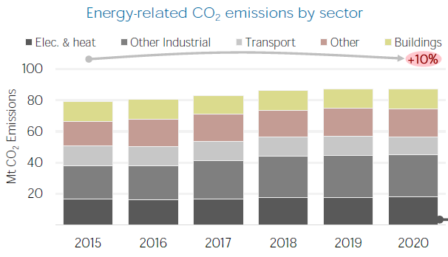
CO2 emissions- Oman
Source: IRENA & Enerdata

Slide 6
ENERGY Projects

Slide 7
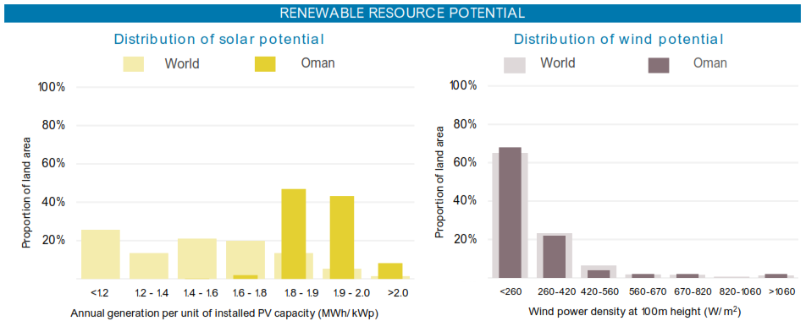
Renewable Resource Potential- Oman
Source: IRENA

Slide 8
Announcement of Clean Energy Projects in Oman In the last five years
Blue Hydrogen
Green Hydrogen
Onshore Wind
Solar – CSP
Solar – PV
Battery
Energy from Waste
Number of Announcements
Announcements by CAPEX
Source: EIC (October 2022)

Slide 9
New Energy Projects in Oman
Green Hydrogen
Onshore Wind
Solar – CSP
Solar – PV
Energy from Waste
Renewable and Waste to Value Projects
Green Hydrogen and Ammonia projects
Source: EIC (October 2022)

Slide 10
Petrofac in Oman

Slide 11
A global leader in energy services
For more than four decades we’ve been serving clients across the globe, designing, building and operating onshore and offshore facilities, and training the people who support them.
From feasibility and conceptual studies, through front-end and detailed design, we think ahead and de-risk project delivery, putting an emphasis on constructability, operability, sustainability and longevity.
Operating safely and sustainably, and known for succeeding with challenging projects, we bring certainty in cost and delivery, and offer a choice of flexible commercial models.
From one-off assignments to fully managed solutions, we deploy digital technologies and develop new techniques to help you reduce costs, enhance productivity, and increase efficiency.
From assessing capability needs, to creating tailored competency programmes, to building and managing training facilities, we help to develop engaged and capable workforces.
We have the skills and know-how to extend production life cost-effectively, as well as enabling you to minimise your operating and abandonment expenditure.
We help our clients meet the world’s evolving energy needs

Slide 12
Petrofac in Oman - Snapshot
Legal Entity: Petrofac E&C Oman LLC
33 years in Sultanate
First EPC project in 1988 – Safah Crude project (Oxy)
More than 15 EPC / EPCm projects All elements of Petrofac’s service capability deployed in country
Supported Clients to arrange UKEF led ECA financing for Duqm project Suhar Refinery also ran through ECA finance mode
Strong partnership with PDO and OQ in different projects and working closely with other partners in Oman such as Shell, BP and OLNG
Supporting local Omani construction companies
(Towell, GPS, Al Turkey, alHassan, others)
ICV
Omanization > 45%
Petrofac’s has spent on local companies approx. USD 3.7 billion
Takatuf Petrofac Oman
US$30 million investment Cutting edge technical training facility opened in April 2018

Slide 13
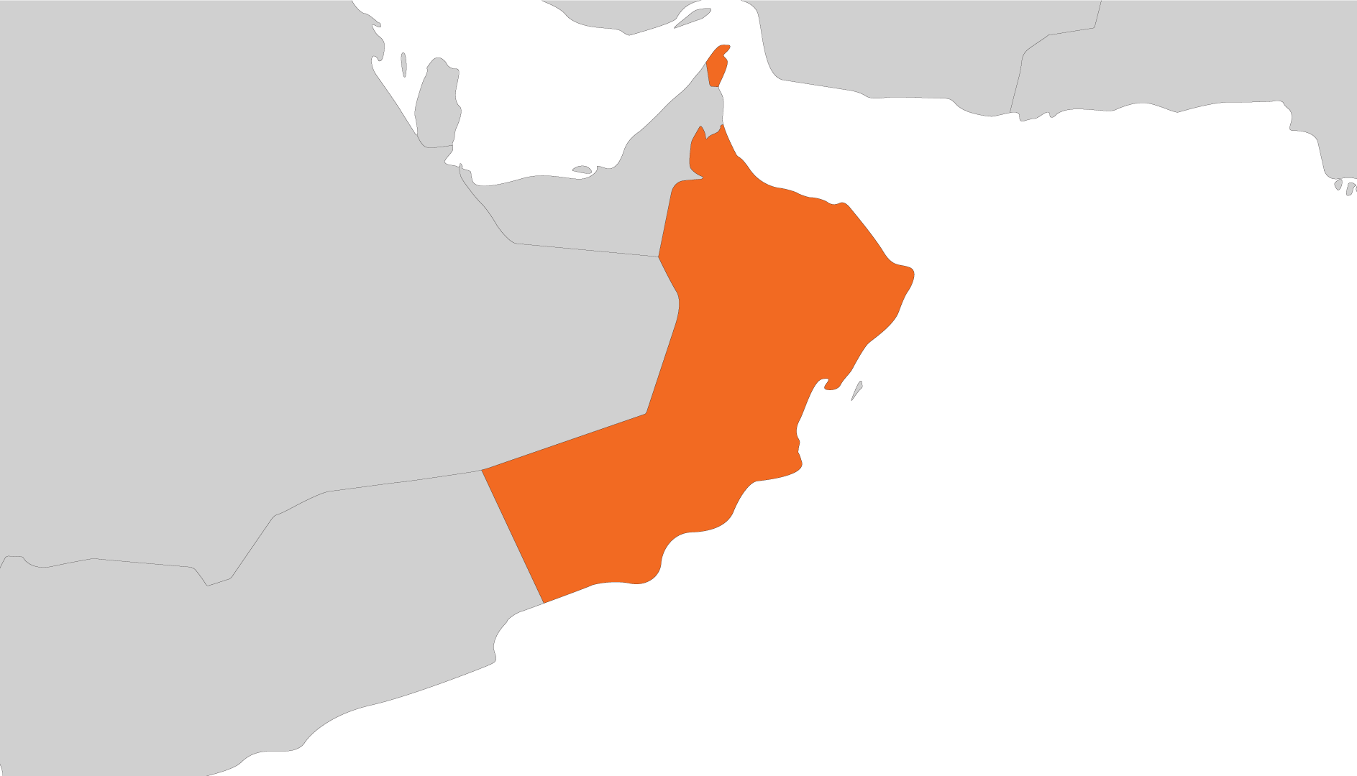
Petrofac Contribution to the ICV Oman [ +$3.7 Bln]
ABB and Musandam Gas Plants (2013)
O&M
ICV: $25M
OOCEP
Suhar Refinery Improvement Project (2013)- EPC
ICV: $569M
ORPIC
Provision of engineering & project support and management services
Reimbursable (7-year contract + 3 Years awarded in 2021)
PDO
Takatuf Petrofac Oman (TPO) Training Center
$30M
Yibal Khuff project (2015)
EPCm,
ICV: $133M
PDO
Kauther Gas Plant
and Depletion Compression (2005 & 2009)
FEED and EPC,
ICV: $153M
PDO
Early History
Occidental Safah crude stabilization project, $12M (1988)
Occidental gas reinjection facility, $14M (1989-90)
PDO, North Oman crude stabilization project, $61M (1992-94)
Khazzan Central Processing Facility (2014)
EPC LS Convertible
ICV: $398M
BP
Khazzan Phase II – Ghazeer (2017)
EPCC
ICV: $330M
BP
Qarn Alam
Co-Generation Project (2018) EPCm
ICV: $27.3M
PDO
Duqm Refinery Project (2018)
EPCC,
ICV: $932M
DRPIC (OOC/KPI)
Mabrouk North East
Development Project (2019)
EPCm
ICV: $28M
PDO
Harweel field
Development (2005)
FEED and EPC
ICV: $300M
PDO
Rabab Harweel
Integrated Project (2014)
EPCm
ICV: $321M
PDO
Marmul Gas Compression Project (2021)
EPC
ICV: $40M (YTD Sep’22)
PDO
Marmul Polymer Phase 3 Project (2018)
EPCm
ICV: $57M
PDO
Salalah LPG Extraction (2017)
FEED Competition and EPC
ICV: $288M
OGC

Slide 14
Delivering the world’s evolving energy needs
.
For ultra-efficient delivery, turn to Petrofac.

